Slide 1

Rt estimation
Andrea Nicolai 1233407
Advanced Statistics 4 Physicists - Final project

Slide 2

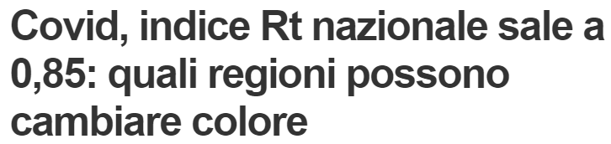




What is Rt
The Effective Reproduction number quantifies, on average, the number of secondary cases that can originate from a primary infection at time t
Why is Rt important?
Overview on epidemics
Checks how much policies are effective
What is NOT Rt

Slide 3
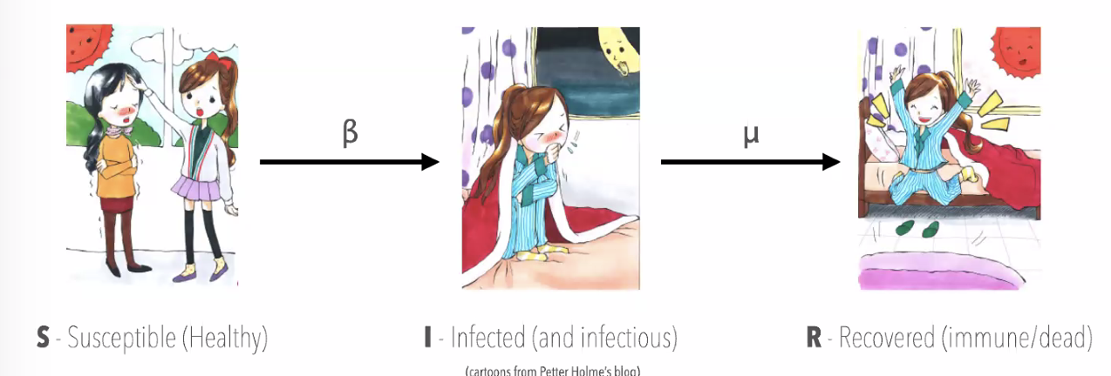
Compartmental models
Consider a network. Each node (i.e. individual) can be described according to its epidemiological state, thus being contained into a compartment:
S: Susceptible individuals
I: Infected (and infectious) individuals
R: Recovered individuals
E: Exposed individuals (takes into account latent period)
and many other more can be introduced...
β,γ,δ,μ... are the rates that describe transitions between compartments

Slide 4
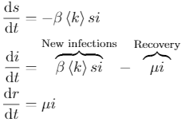
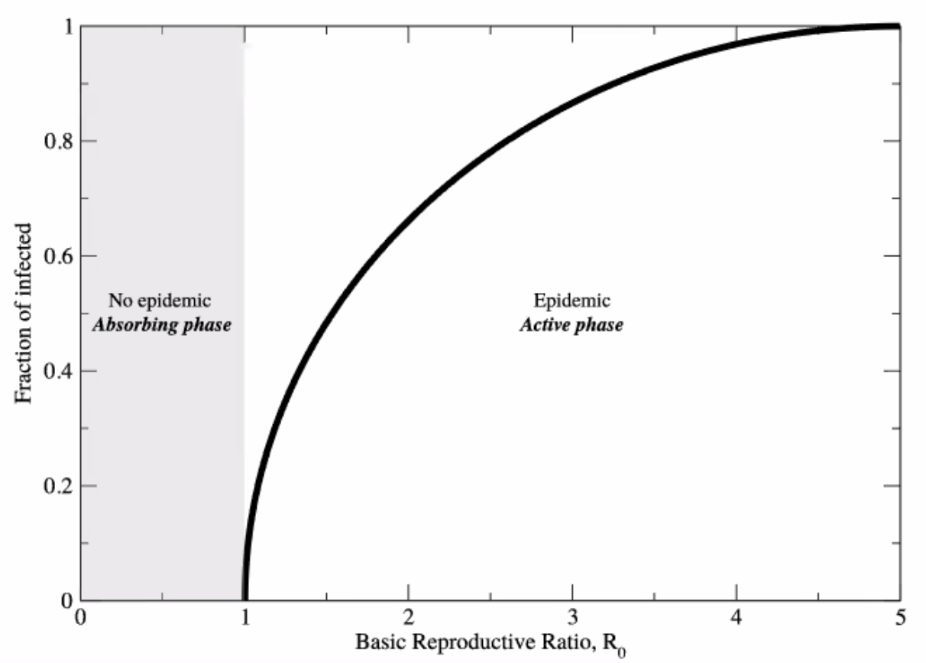
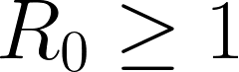
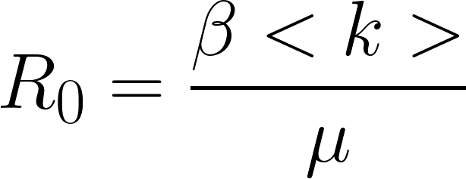
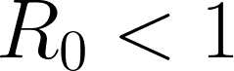
SIR compartmental model
Differential equations describing compartments rate transitions.
where:
s(t) = S(t)/N
i(t) = I(t)/N
r(t) = R(t)/N
s(t) + i(t) + r(t) = 1
N is the total population
(constant, assuming no deaths nor births)
<k> is the average number of contacts
For small t~0 it is reasonable to assume s~1 and r~0. Hence:
Where R0 is the “basic reproduction rate” and is peculiar of the disease.
Spreading
NOT Spreading

Slide 5
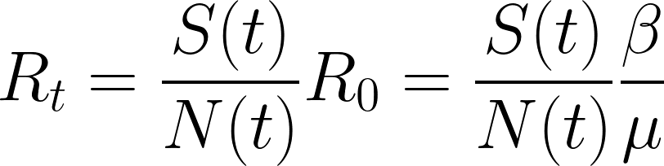
Estimating Rt
If τ<<1 one can assume S(t)/N(t) to be constant.
Where we have introduced Rt:
The number of infections on given day (t+τ) does depend both on the disease (through μ,β), how many are actually infected (infectious) on a given day (t) and the Effective reproduction ratio Rt

Slide 6
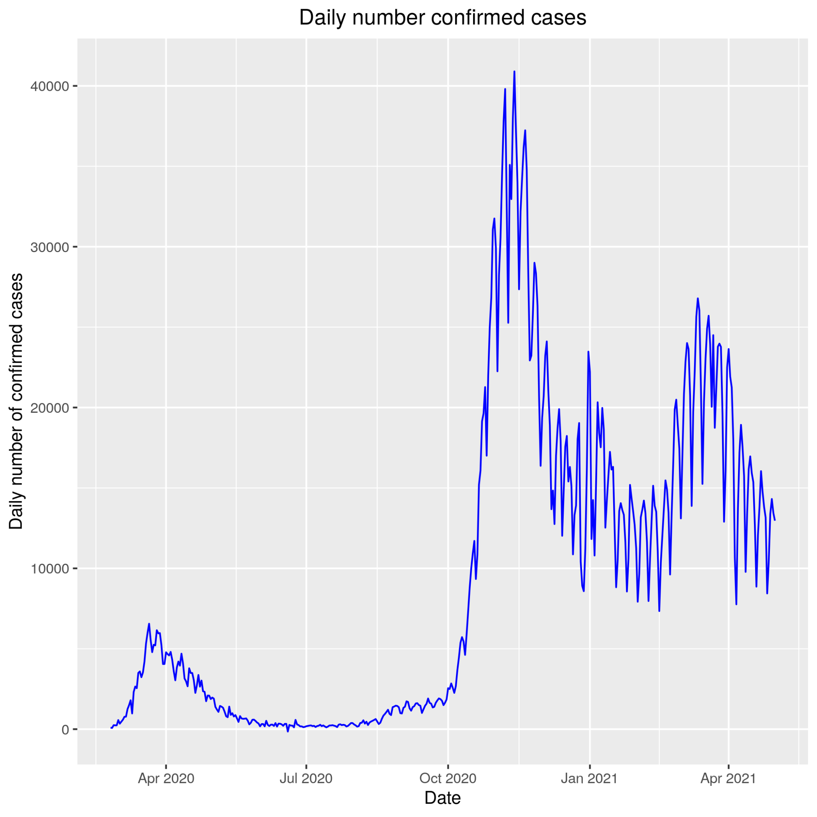
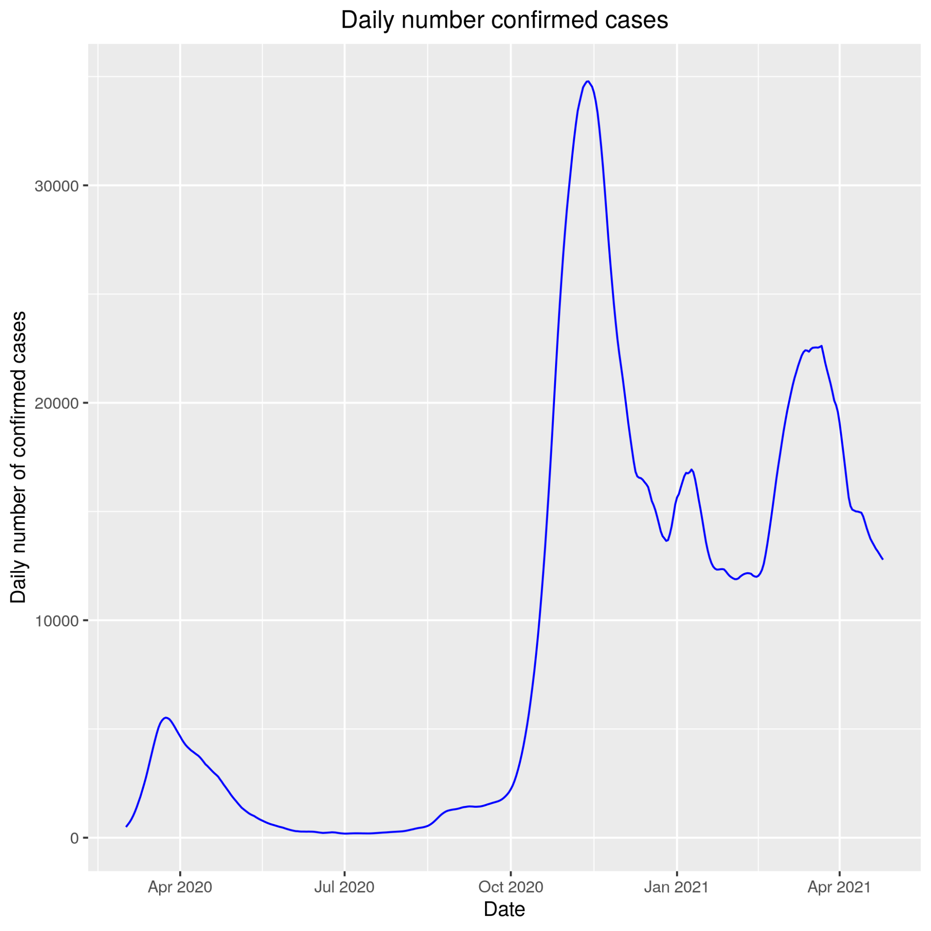
Our dataset (ITALY)
Rolling average filter
(7 days)

Slide 7
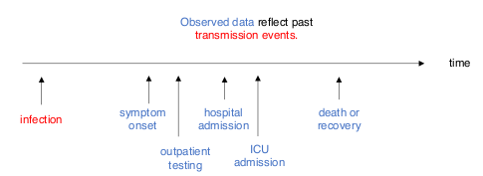
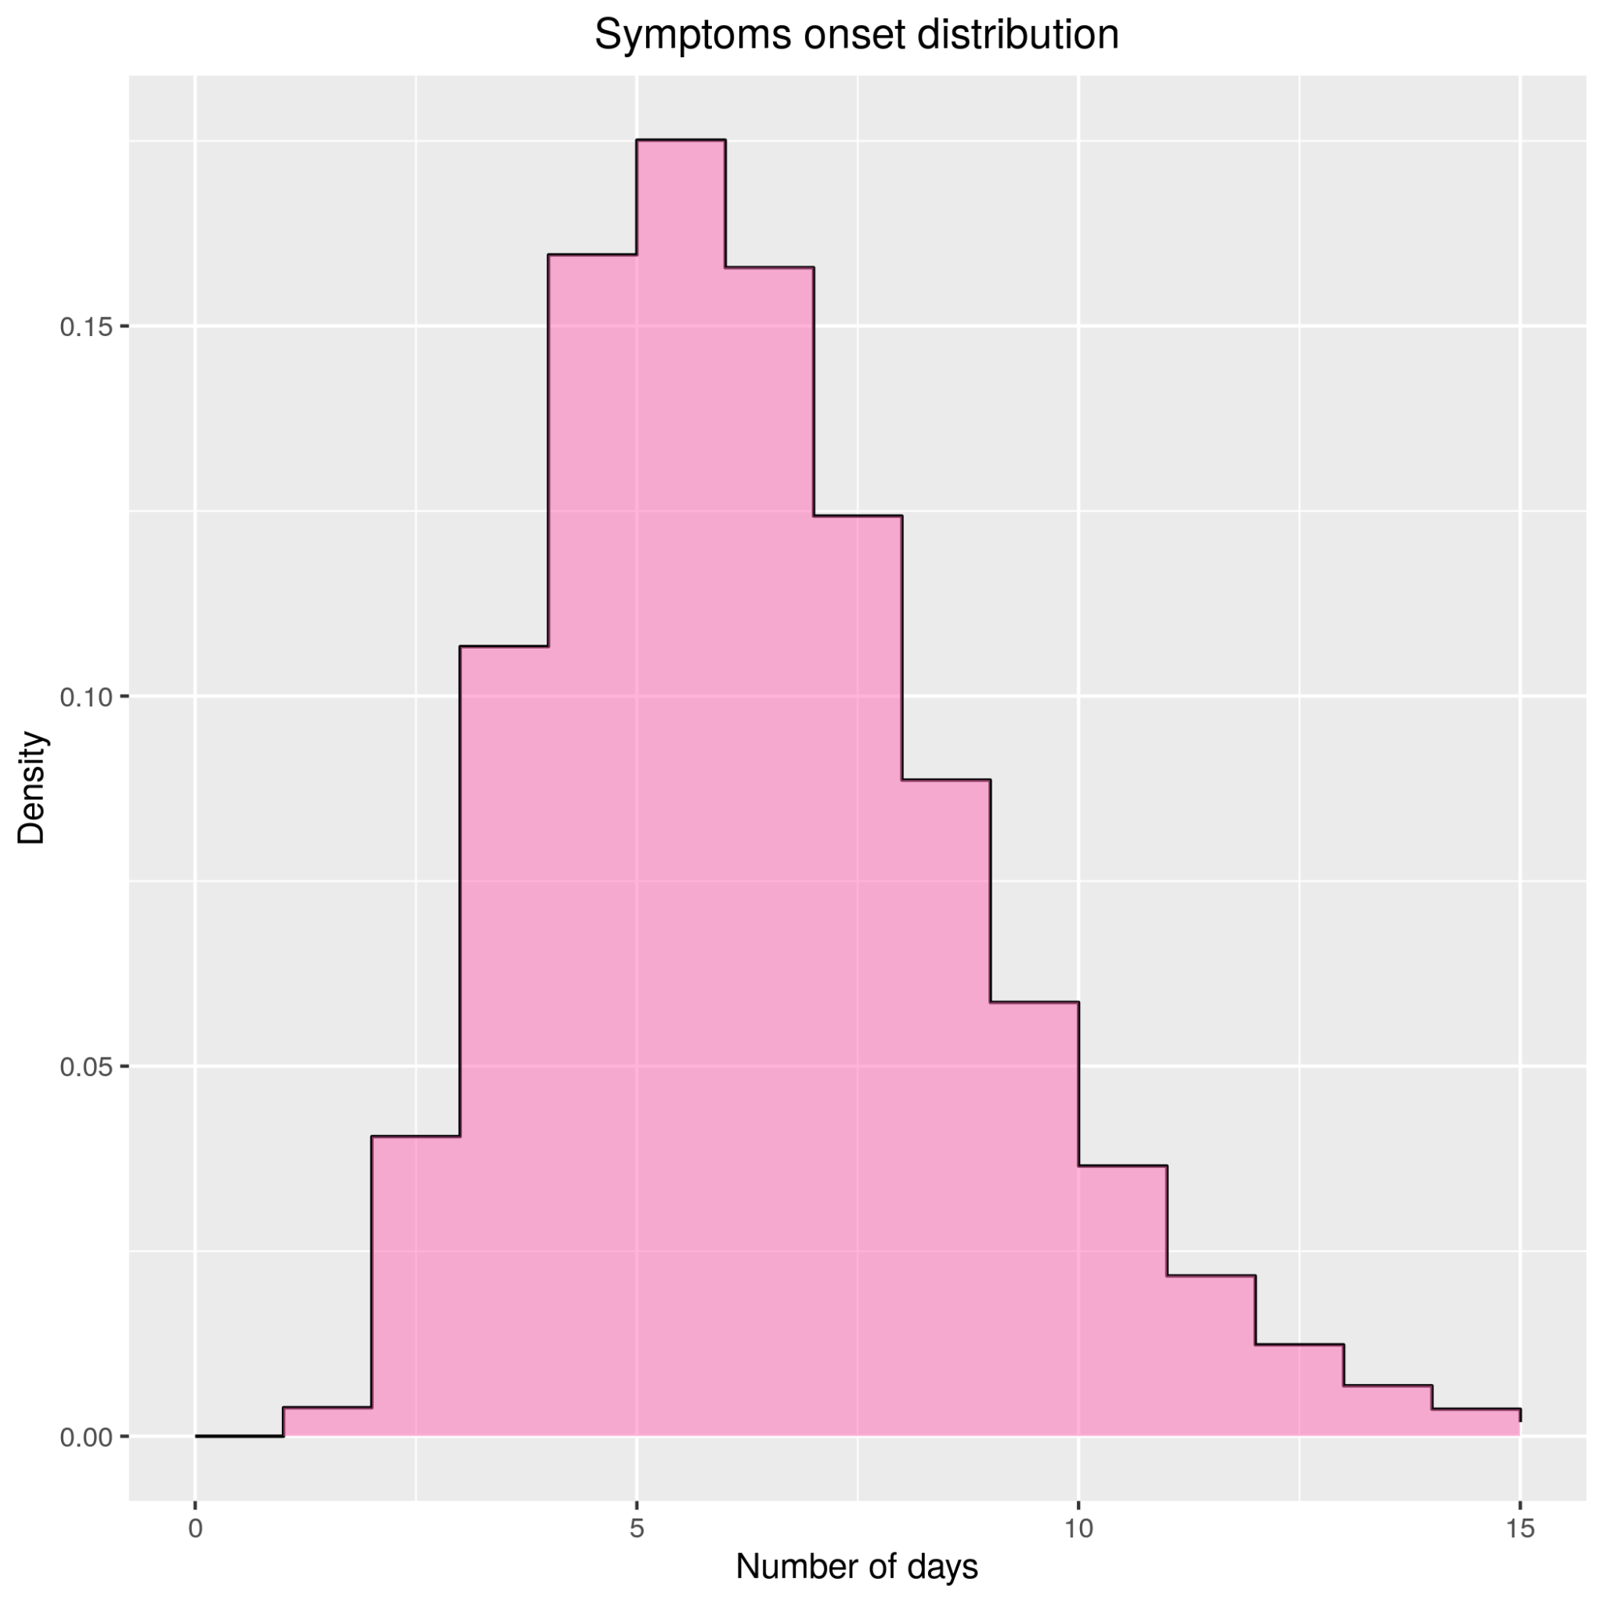
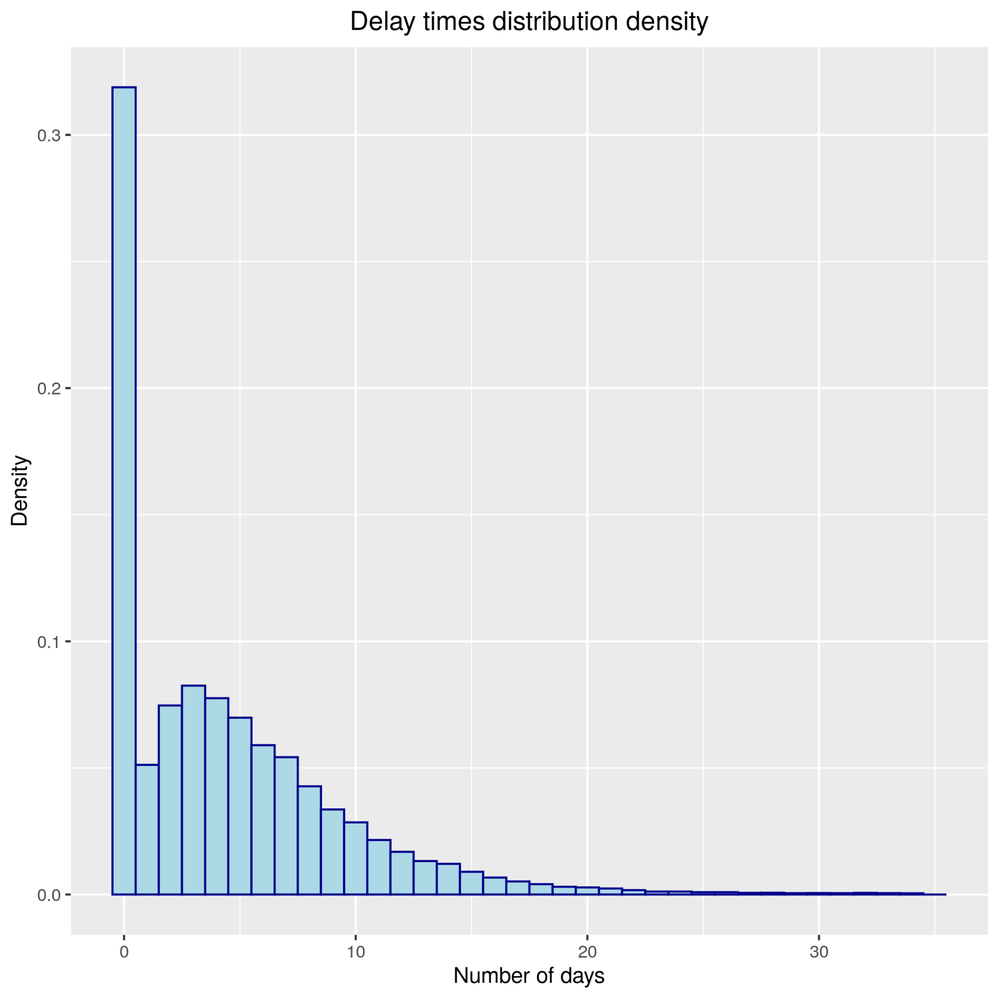
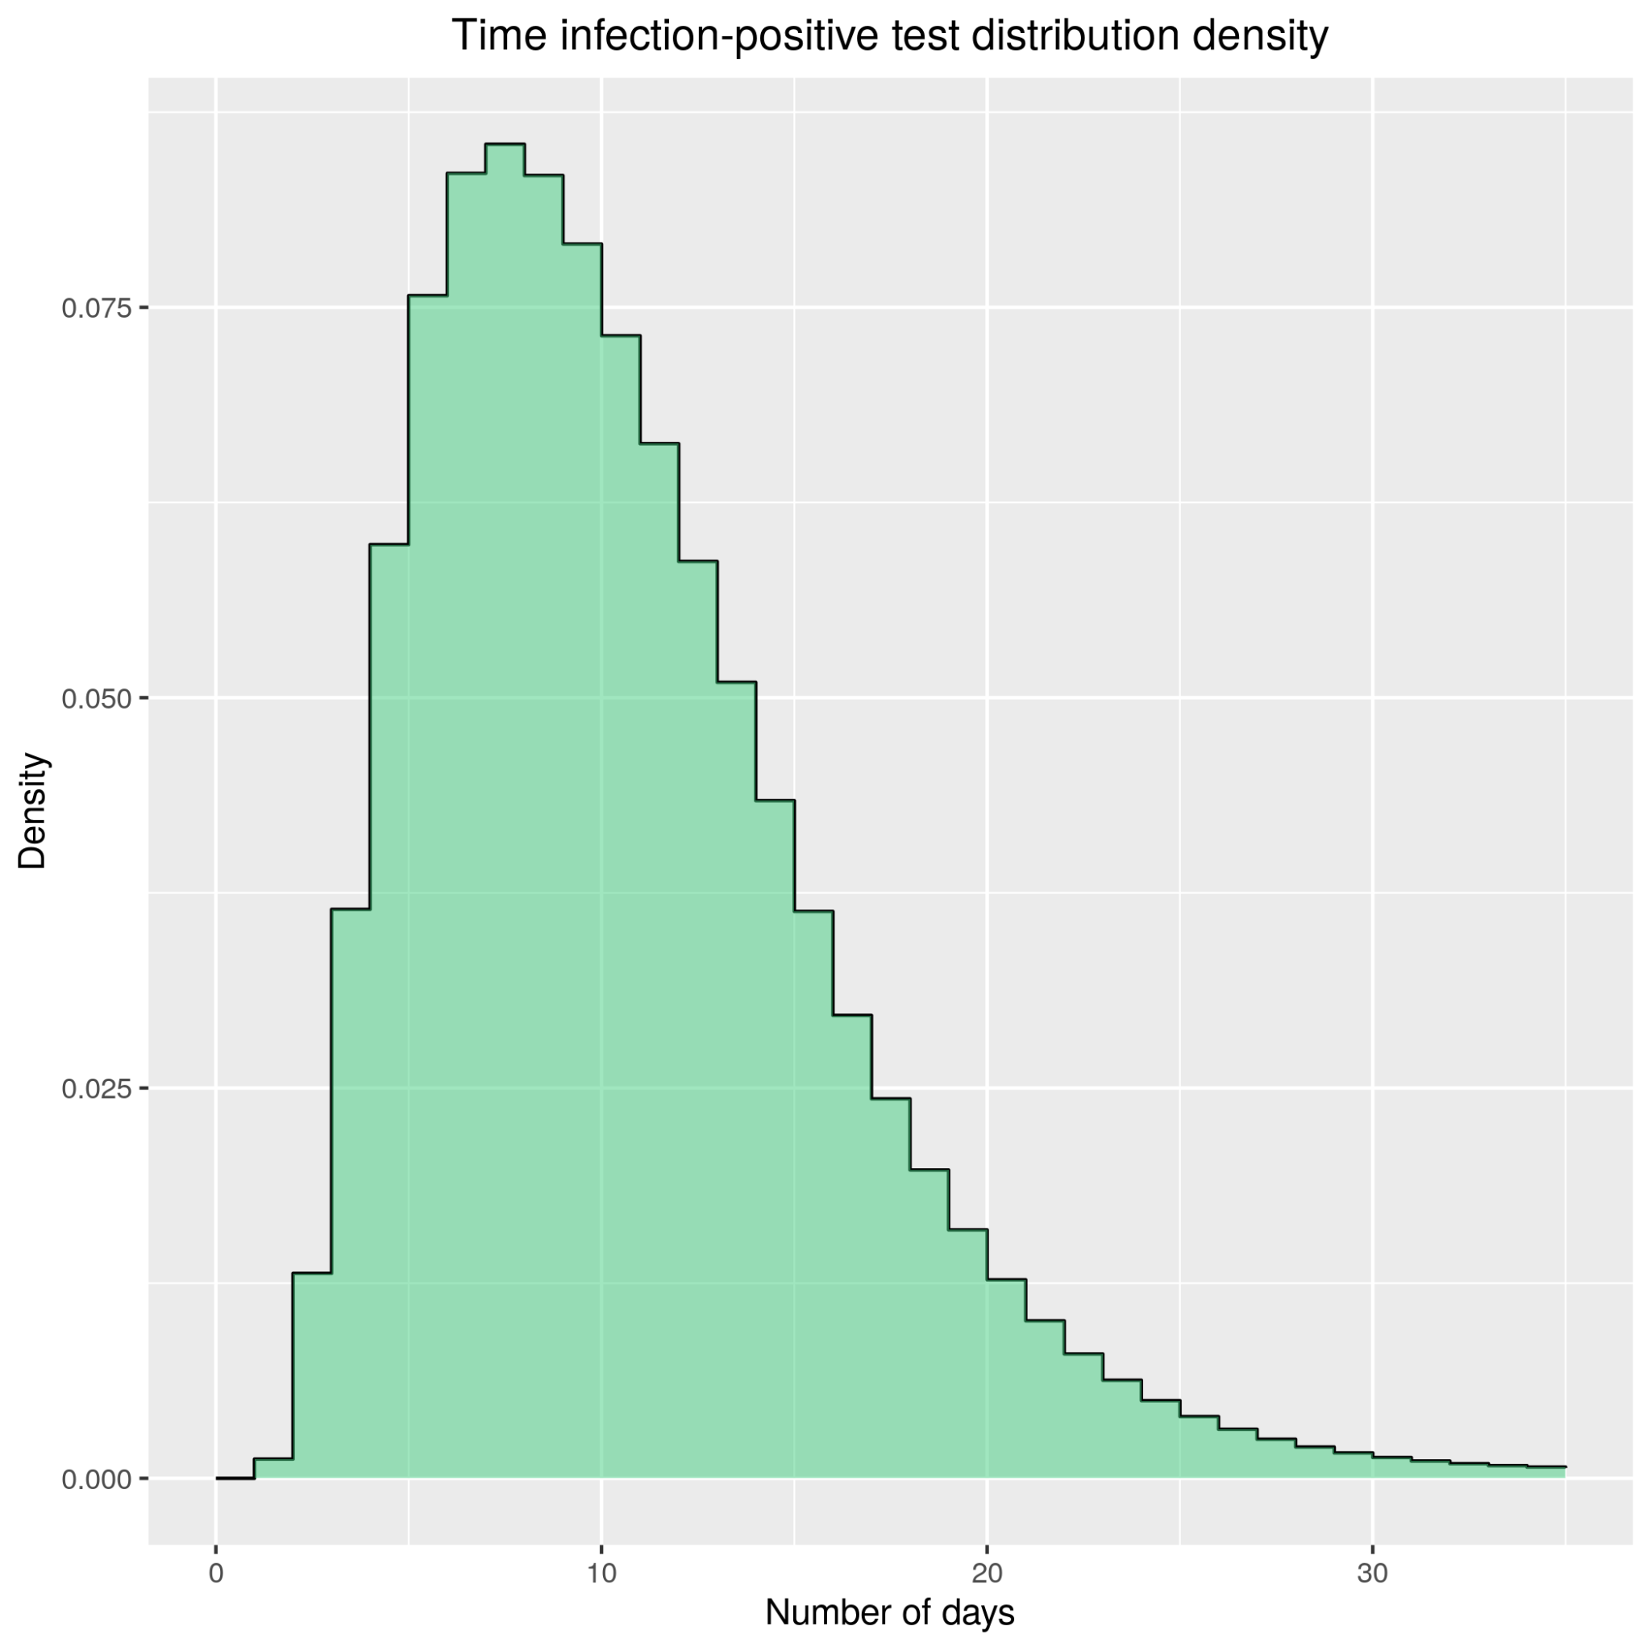
Our observable:
daily number of positive tests
Gamma
(shape = 5.81 , rate = 0.98)
Symptoms onset distribution
(literature)
Delay distribution
(empirical)
Number of days elapsed from infection -> Symptoms onset -> testing + result (observable)

Slide 8
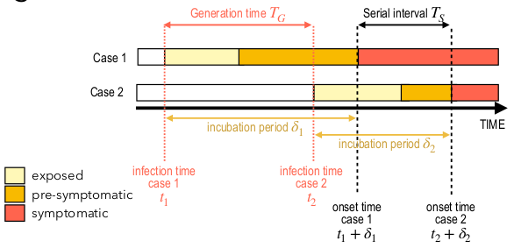
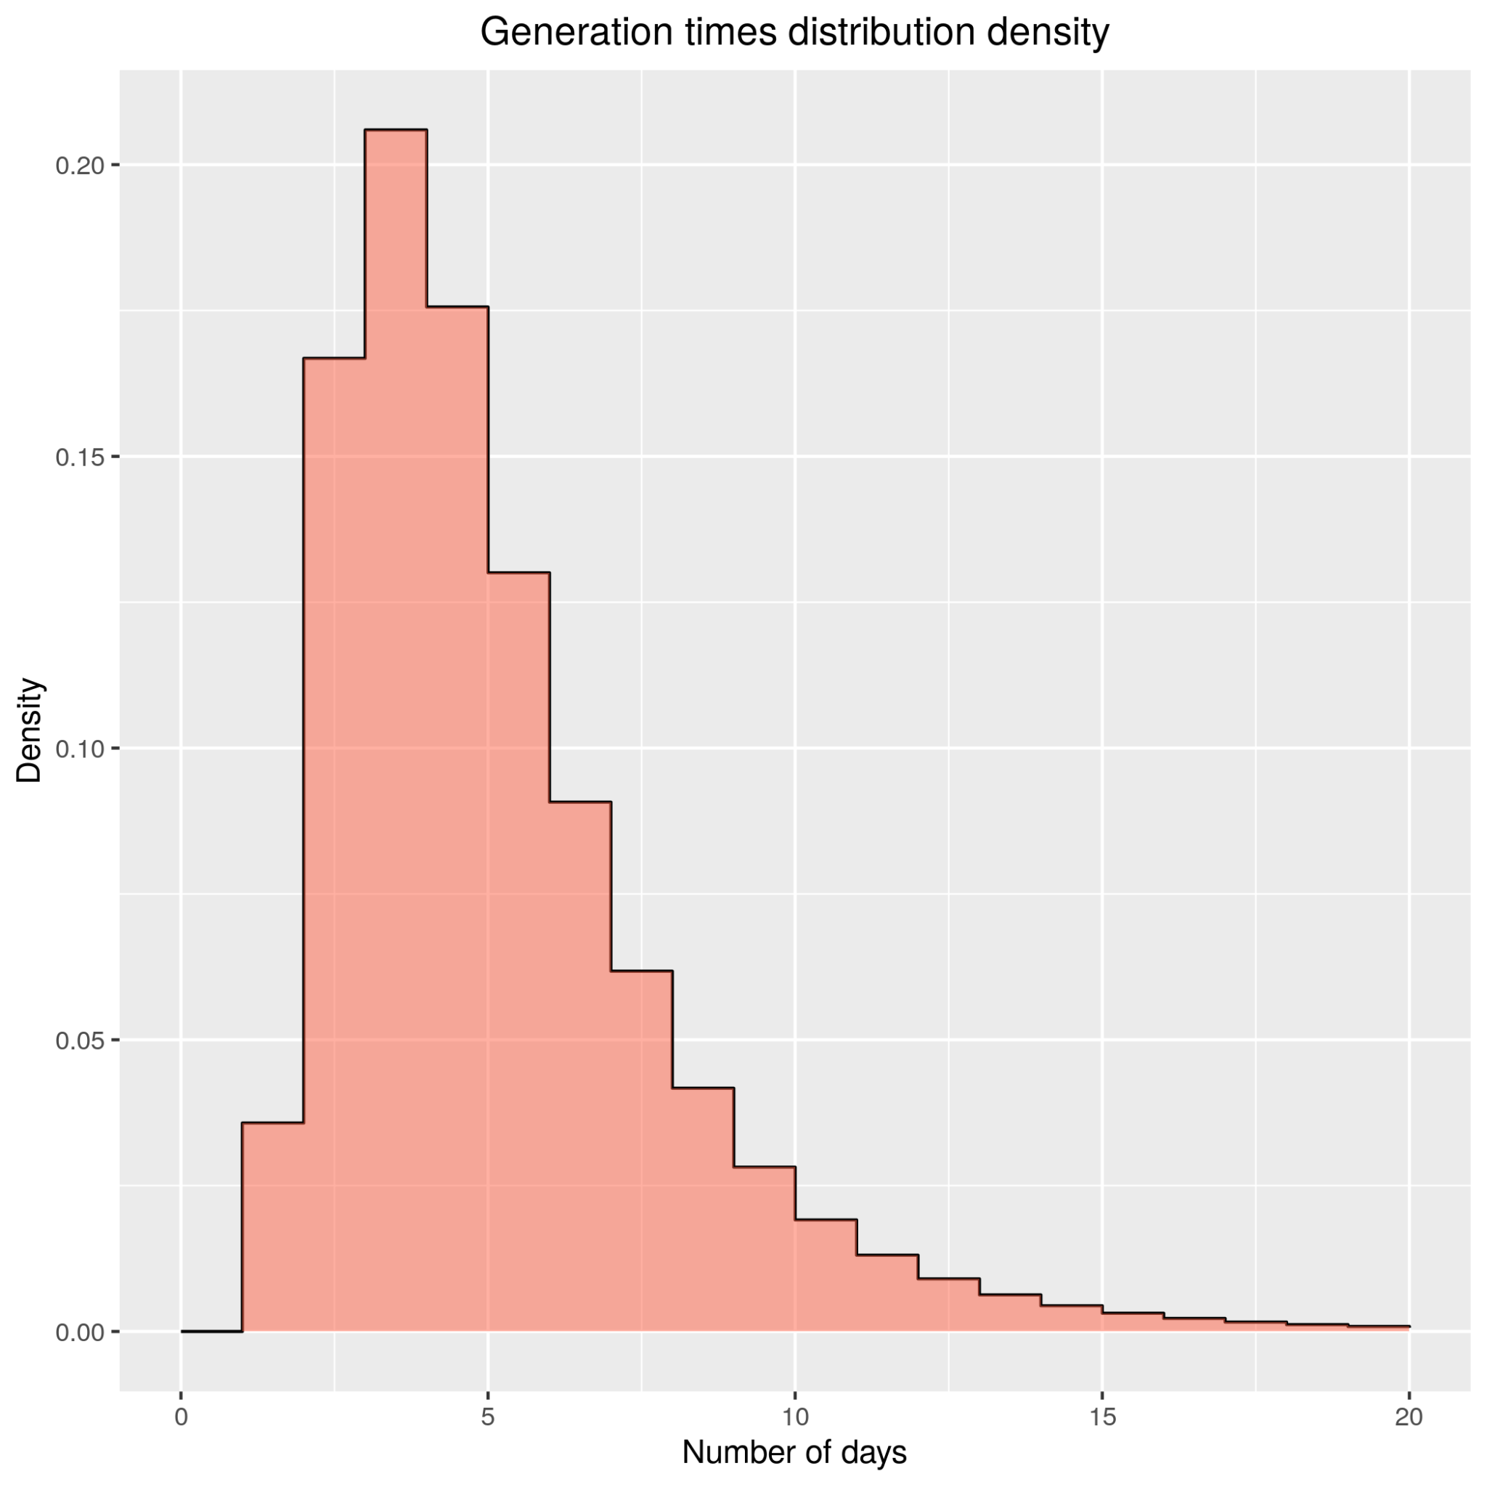
Serial interval
Generation times distribution:
time that elapses between the primary and secondary infection
Serial interval distribution:
time that elapses between the primary and secondary symptoms onset times
Serial interval is used as a proxy for the generation time.
Indeed expectation value is the same one, at a cost of larger variance
Gamma
(mu = 4.7, sigma =2.9)
It reflects the fact that infectivity varies in time...

Slide 9
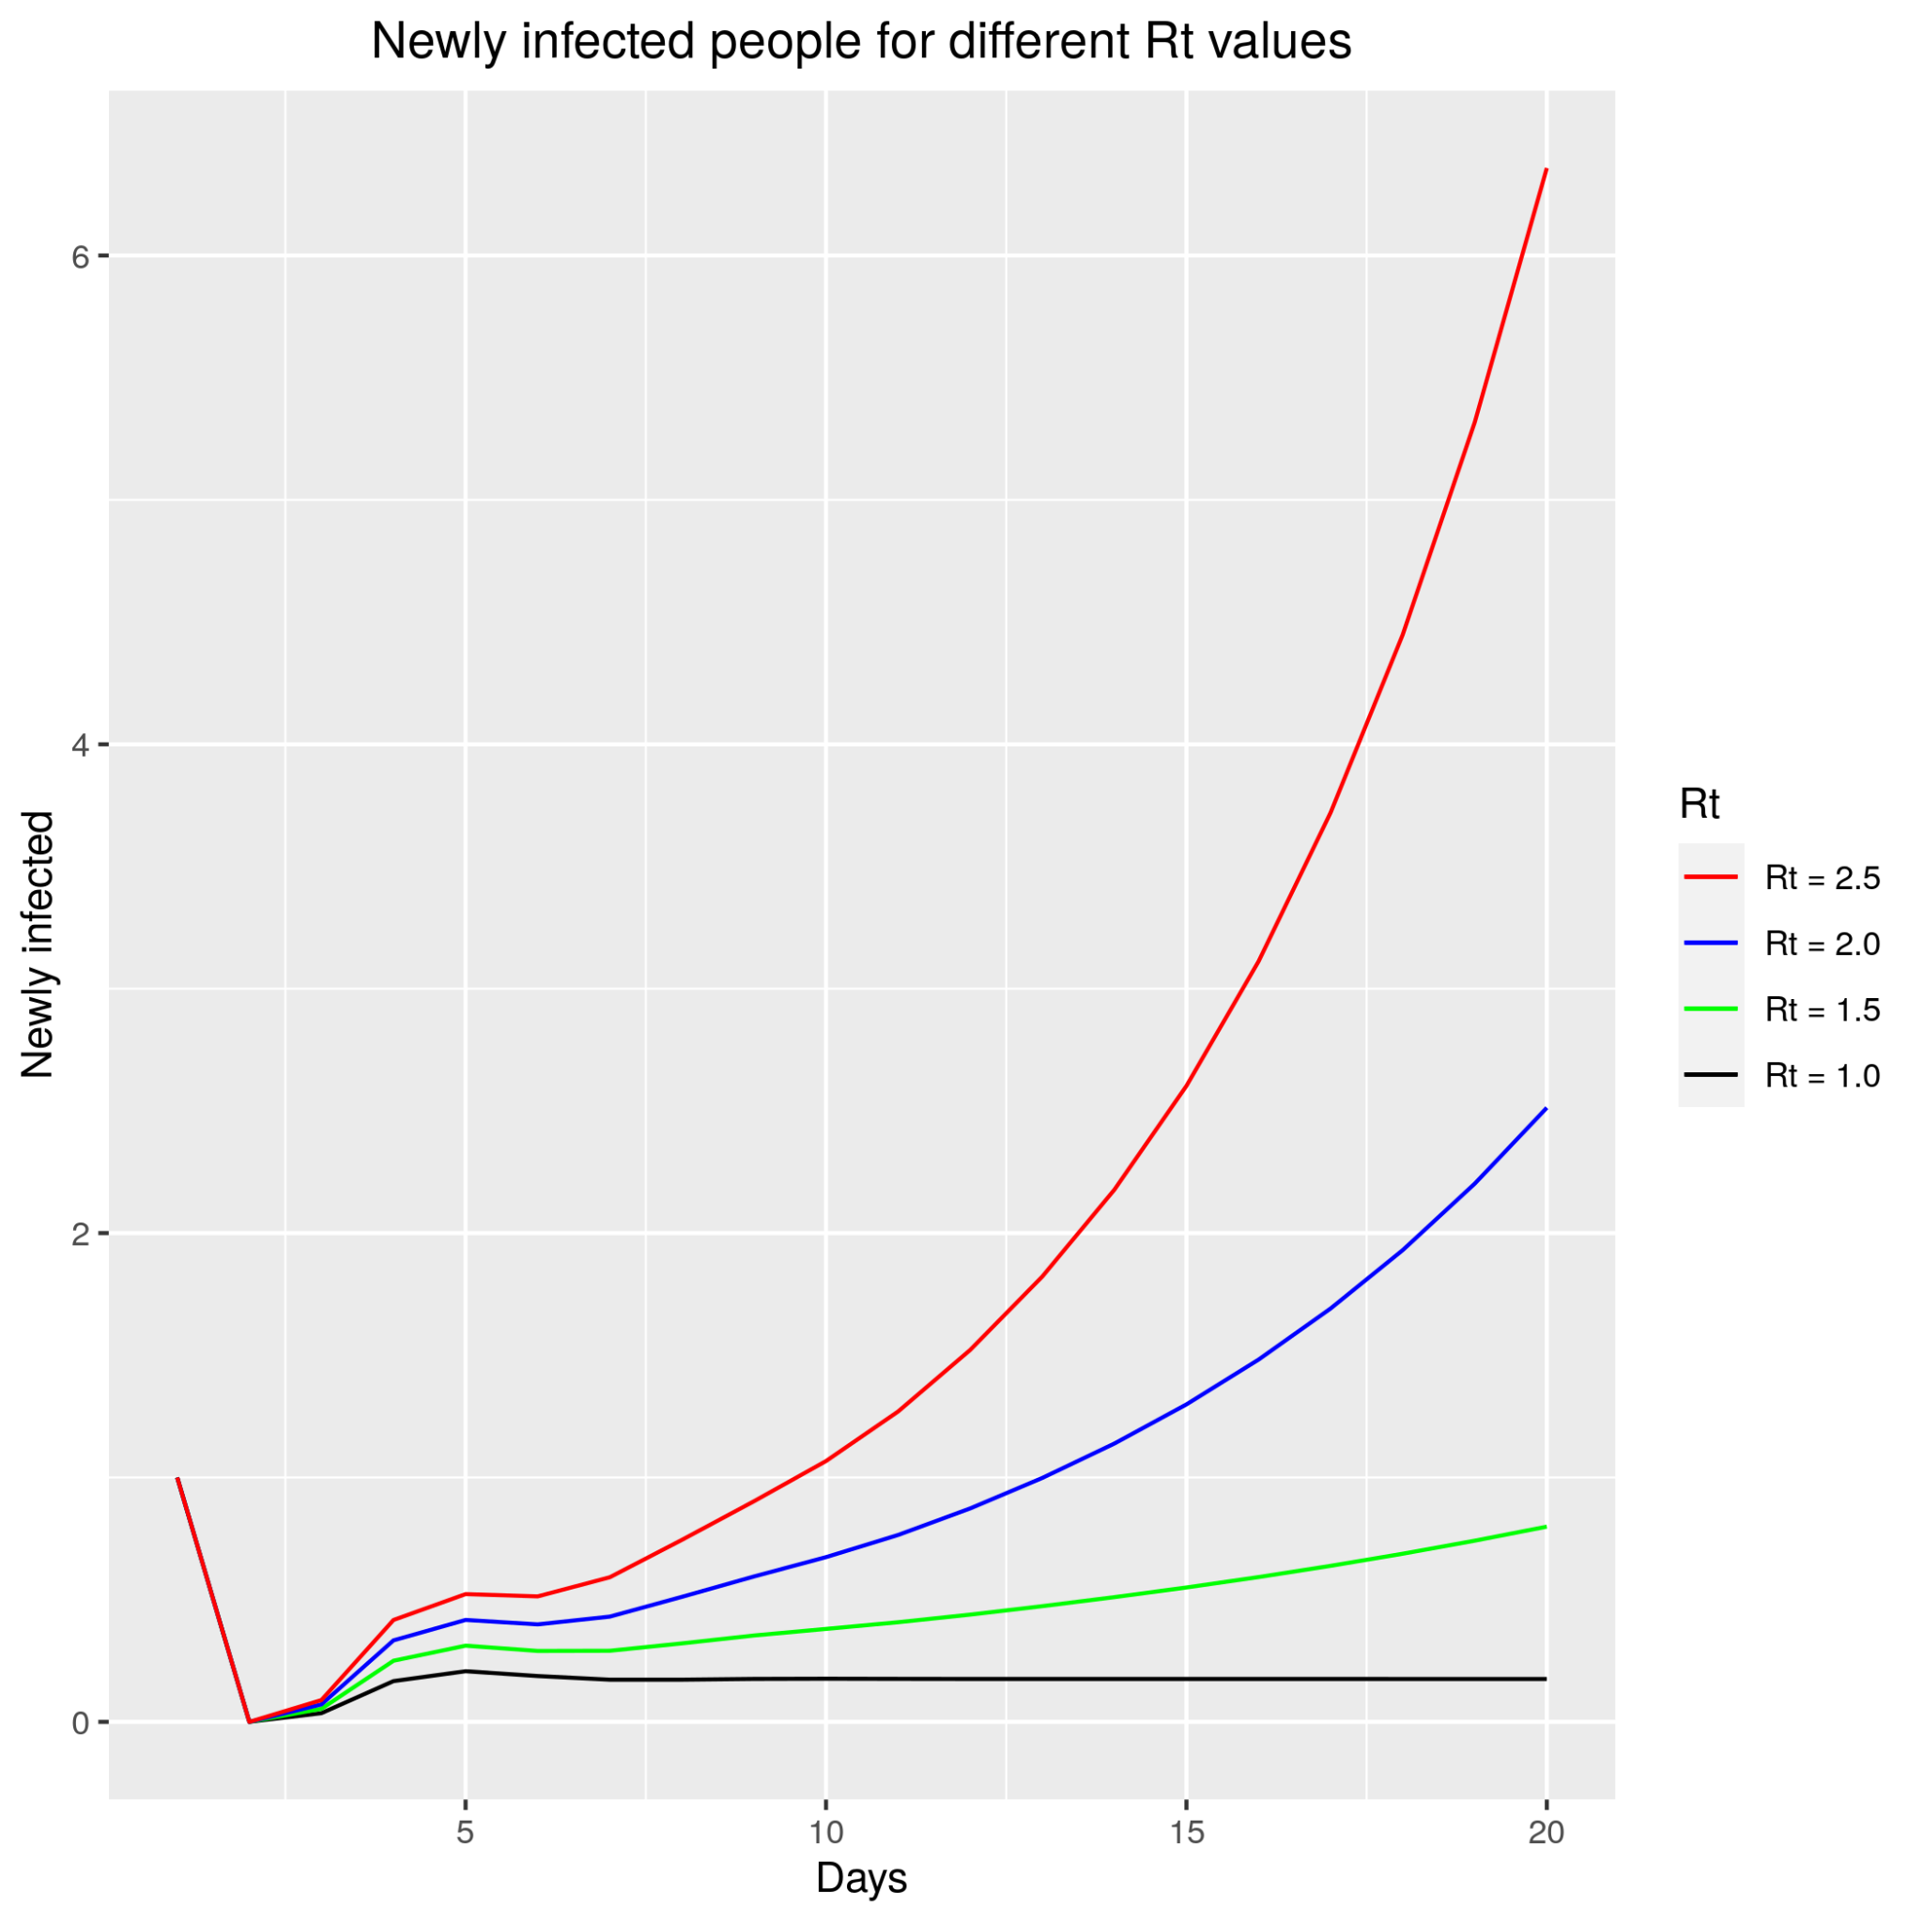
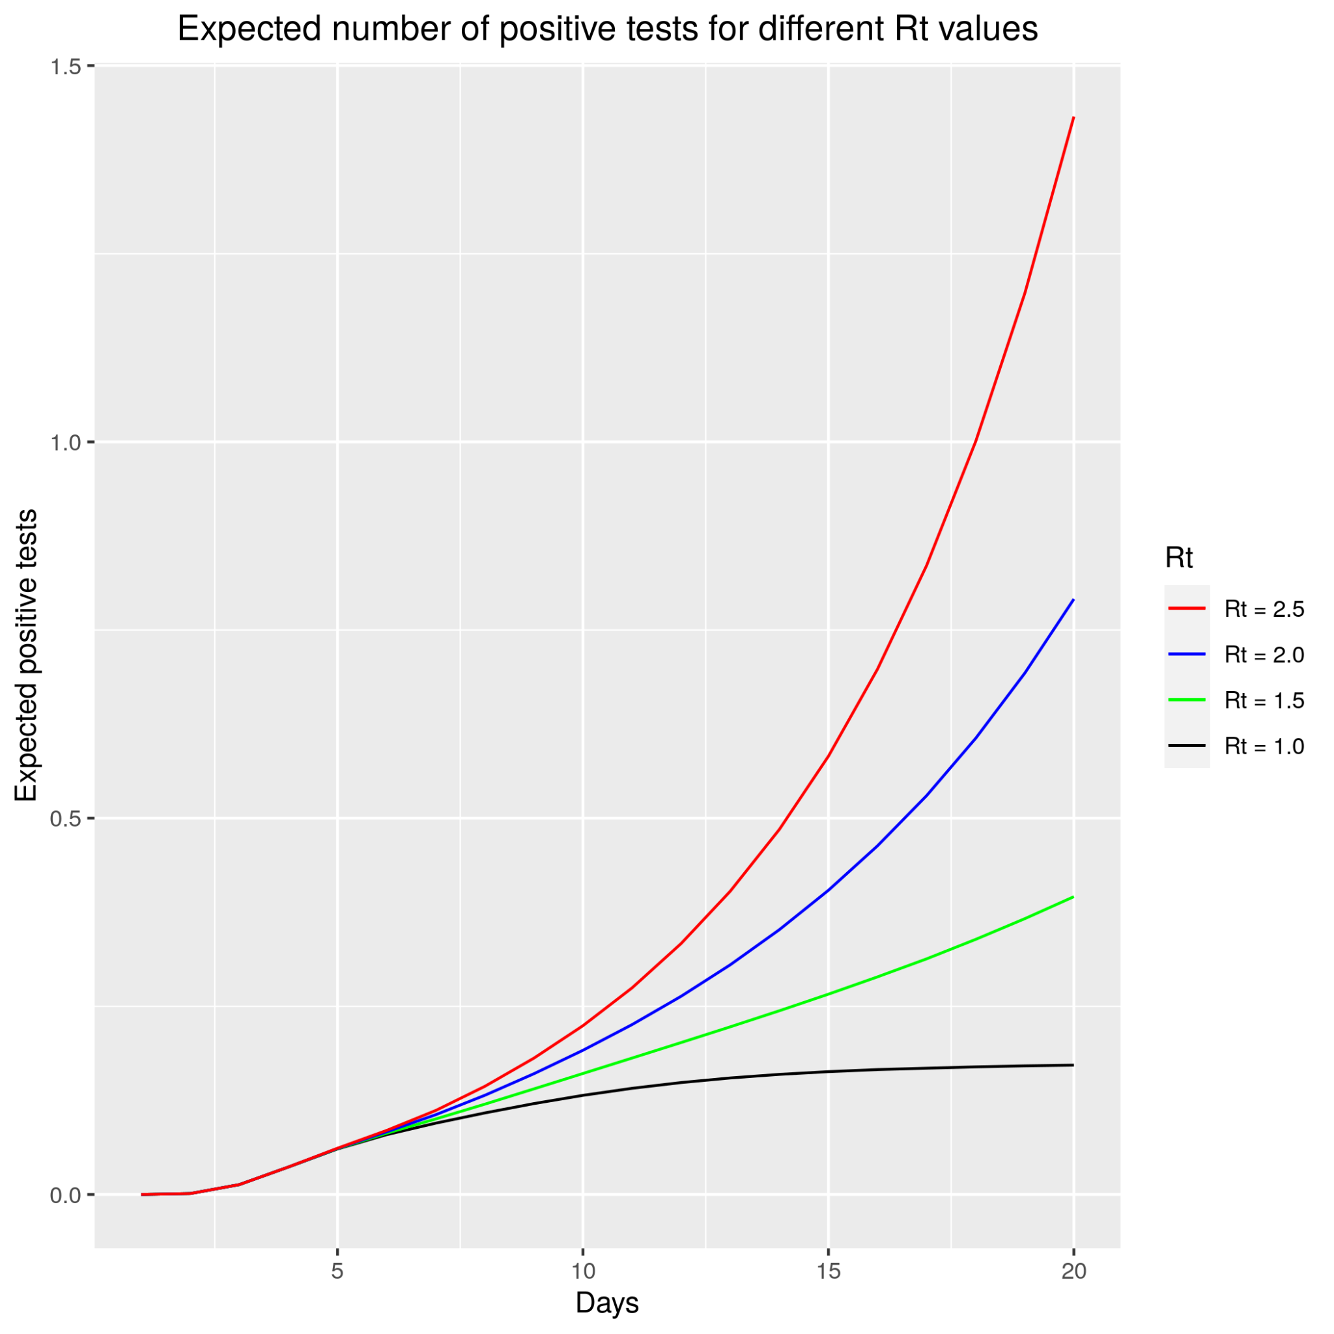
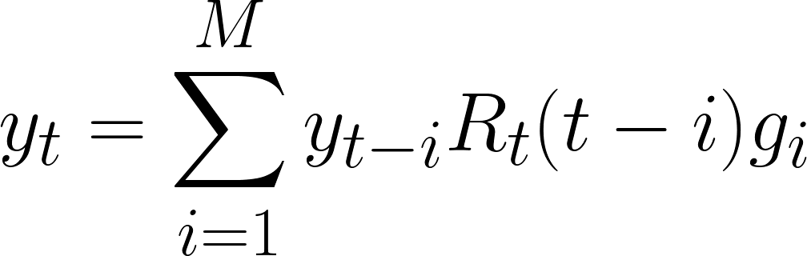
How Rt drives infections
Using the just mentioned distributions, we see as the number of new infections and the expected number of positive tests varies in time given a single infected individual at time t=0
Briefly: the larger Rt, the faster the epidemics will spread.

Slide 10
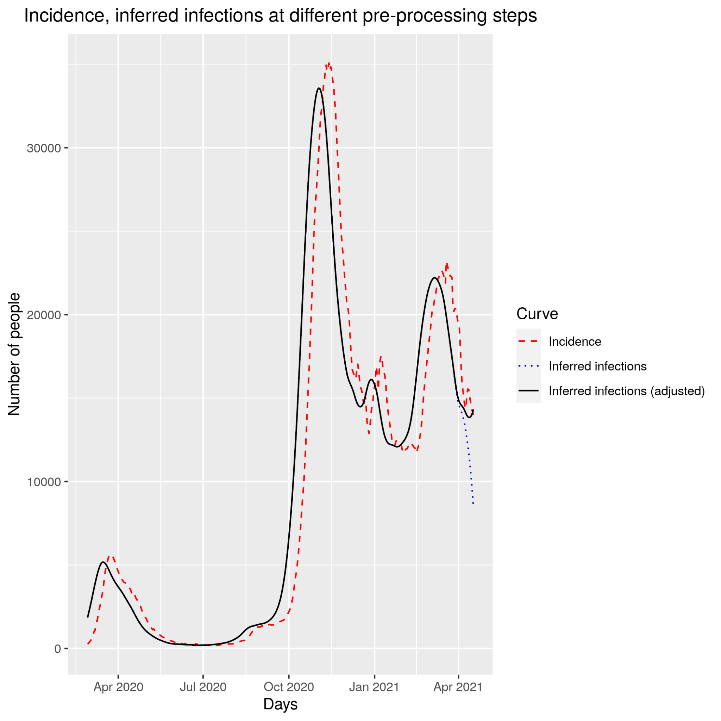
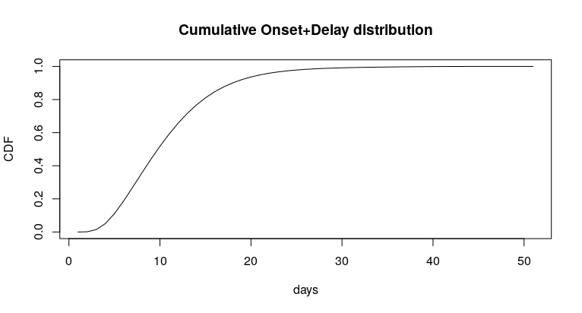
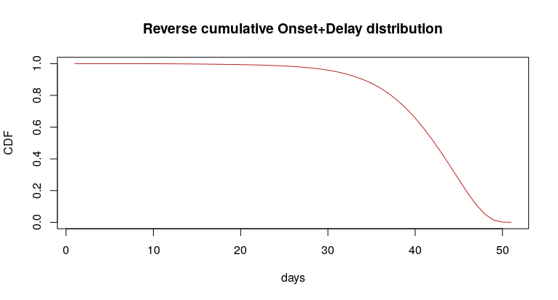
What do we need
We need a way to relate our observable (i.e. daily number of positive tests) to when infections occurred.
Hence:
Make a “past” Convolution between the “reversed” new positive curve and the delay+onset distribution previously obtained
Right ankle adjustment, by normalizing the inferred infection wrt the cumulative delay+onset distribution

Slide 11
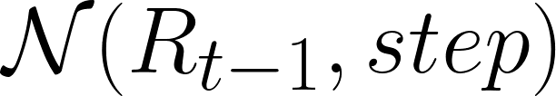
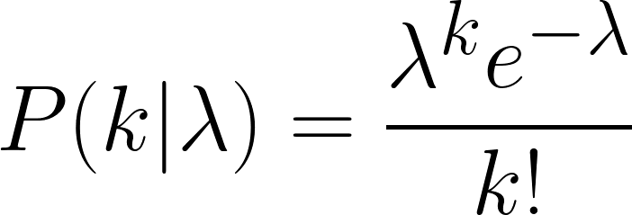
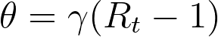
Our Bayesian Model
The Prior
Gaussian Random Walk
Assumption: Rt distributes as a Gaussian with parameters
Step size is found from literature to be equal to 0.03
The Likelihood
Poisson: the number of today’s inferred infections follows a Poisson
Whose parameter λ is the expected number of infections, given a certain Rt
Where k_t is the number of infected individuals at time t and γ distributes as the 1/generation times distribution, θ varying according to Gaussian Random Walk
The Posterior
t = 1
t = 2
t = ...

Slide 12
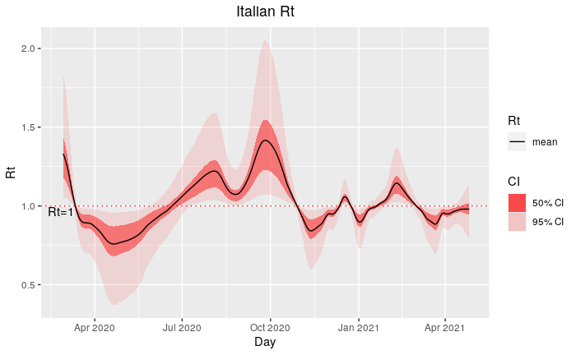
Our Results

Slide 13
Our Results - a comparison

Slide 14
Conclusions
What we have done
We have used Bayesian inference to estimate Rt, using Bettencourt & Ribeiro 2008 method.
What can be done next
Improve the bayesian model
Likelihood: use other distributions, modelling the process differently
We assumed perfect tests (100% sensitivity and 100% specificity)
We assumed that every infected shows symptoms (not true…)
We assumed every infected is to be tested
Introduce new compartments, thus new rates, for example including Exposed class and improving the linearization techniques.
Introduce the dependence of the observable on the number of tests performed (i.e. include “exposure”)

Slide 15

Thank you
for attention

